Slide 1
MicroServices
Shalini Mittal
Corporate Trainer

Slide 2
Topics to be covered
Overview of Monolithic Application vs Microservices
Decomposition of microservices
Refactoring to microservices
Service Discovery
Circuit Breaker
API Gateway
Externalize configuration

Slide 3
Make small programs from an entire application. The application still needs to behave as a single entity but having properties of smaller programs

Slide 4
A distinctive method of developing software systems that tries to focus on building single-function modules with well-defined interfaces and operations.

Slide 5
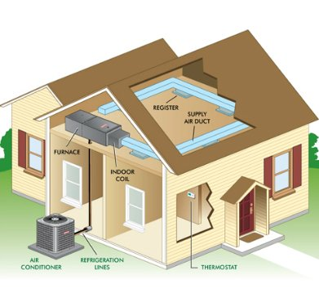
HVAC SYSTEM
Notes:
This system may consist of a furnace, air conditioner, humidifier, thermostat, and fresh-air exchanger. When you’re in your house, you never go to the humidifier or furnace and flip a switch to turn it on; instead, you make adjustments on the thermostat. Each individual system comes in a box from a manufacturer, and they’re all connected, yet each acts as a single unit. You can swap the gas furnace out for an electric model, and the operation stays the same for you and your family. When you adjust the thermostat in your house, you don’t need to know what kind of furnace or air conditioner you have; you just know your thermostat. In this metaphor, each HVAC component is a service, and the whole design of your HVAC system is your microservices architecture.
An HVAC system in a house is something that is changed maybe once a decade, but software architectures are far more dynamic. Cloud instances go up and down and new versions are deployed sometimes many times per day. Plus, HVAC systems have very simplistic inputs and a small number of connections. A microservices architecture may have thousands (millions even!) of inputs that may route to do many complex activities, not just regulate the climate of your house

Slide 6
Real Life Scenario
Insurance.com
Policy
Claims
Support
Notes:
Customer logon to insurance company portal and can do one of the following –
Buy Policy
Raise a Claim
Support – Change address, phone number etc

Slide 7
Monolithic Architecture
WAR
UI
Policy Service
Database
Browser
Apache
Claim Service
Support Service
TOMCAT

Slide 8
Pros and Cons
Pros
Cons
Simple to develop
Simple to deploy
Simple to scale
Difficult to maintain
Overloaded IDE
Overloaded WebContainer
Continuous deployment is difficult
Scaling the application can be difficult
Obstacle to scaling development
Requires a long-term commitment to a technology stack
Notes:
Pros
Simple to develop - the goal of current development tools and IDEs is to support the development of monolithic applications
Simple to deploy - you simply need to deploy the WAR file (or directory hierarchy) on the appropriate runtime
Simple to scale - you can scale the application by running multiple copies of the application behind a load balancer
Cons
However, once the application becomes large and the team grows in size, this approach has a number of drawbacks that become increasingly significant:
The large monolithic code base intimidates developers, especially ones who are new to the team. The application can be difficult to understand and modify. As a result, development typically slows down. Also, because there are not hard module boundaries, modularity breaks down over time. Moreover, because it can be difficult to understand how to correctly implement a change the quality of the code declines over time. It’s a downwards spiral.
Overloaded IDE - the larger the code base the slower the IDE and the less productive developers are.
Overloaded web container - the larger the application the longer it takes to start up. This had have a huge impact on developer productivity because of time wasted waiting for the container to start. It also impacts deployment too.
Continuous deployment is difficult - a large monolithic application is also an obstacle to frequent deployments. In order to update one component you have to redeploy the entire application. This will interrupt background tasks (e.g. Quartz jobs in a Java application), regardless of whether they are impacted by the change, and possibly cause problems. There is also the chance that components that haven’t been updated will fail to start correctly. As a result, the risk associated with redeployment increases, which discourages frequent updates. This is especially a problem for user interface developers, since they usually need to iterative rapidly and redeploy frequently.
Scaling the application can be difficult - a monolithic architecture is that it can only scale in one dimension. On the one hand, it can scale with an increasing transaction volume by running more copies of the application. Some clouds can even adjust the number of instances dynamically based on load. But on the other hand, this architecture can’t scale with an increasing data volume. Each copy of application instance will access all of the data, which makes caching less effective and increases memory consumption and I/O traffic. Also, different application components have different resource requirements - one might be CPU intensive while another might memory intensive. With a monolithic architecture we cannot scale each component independently
Obstacle to scaling development - A monolithic application is also an obstacle to scaling development. Once the application gets to a certain size its useful to divide up the engineering organization into teams that focus on specific functional areas. For example, we might want to have the UI team, accounting team, inventory team, etc. The trouble with a monolithic application is that it prevents the teams from working independently. The teams must coordinate their development efforts and redeployments. It is much more difficult for a team to make a change and update production.
Requires a long-term commitment to a technology stack - a monolithic architecture forces you to be married to the technology stack (and in some cases, to a particular version of that technology) you chose at the start of development . With a monolithic application, can be difficult to incrementally adopt a newer technology. For example, let’s imagine that you chose the JVM. You have some language choices since as well as Java you can use other JVM languages that inter-operate nicely with Java such as Groovy and Scala. But components written in non-JVM languages do not have a place within your monolithic architecture. Also, if your application uses a platform framework that subsequently becomes obsolete then it can be challenging to incrementally migrate the application to a newer and better framework. It’s possible that in order to adopt a newer platform framework you have to rewrite the entire application, which is a risky undertaking.

Slide 9
Decomposition

Slide 10
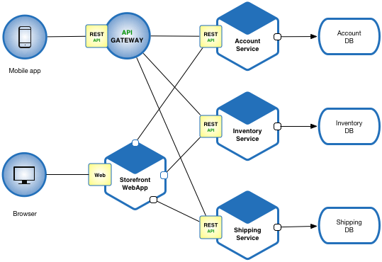
Decomposition
Policy DB
Policy Service
Claim DB
Claim Service
UI
Customer DB
Support Service
Notes:
Define an architecture that structures the application as a set of loosely coupled, collaborating services. This approach corresponds to the Y-axis of the Scale Cube. Each service is:
Highly maintainable and testable - enables rapid and frequent development and deployment
Loosely coupled with other services - enables a team to work independently the majority of time on their service(s) without being impacted by changes to other services and without affecting other services
Independently deployable - enables a team to deploy their service without having to coordinate with other teams
Capable of being developed by a small team - essential for high productivity by avoiding the high communication head of large teams
Services communicate using either synchronous protocols such as HTTP/REST or asynchronous protocols such as AMQP. Services can be developed and deployed independently of one another. Each service has its own database in order to be decoupled from other services. Data consistency between services is maintained using the Saga pattern

Slide 11
Decompose by Business Capability
A service must be small enough to be developed by a small team and to be easily tested.
Apply the SRP to service design as well and design services that are cohesive and implement a small set of strongly related functions.
The application also be decomposed in a way so that most new and changed requirements only affect a single service.
Common Closure Principle (CCP), which states that classes that change for the same reason should be in the same package.
A business capability is a concept from business architecture modeling. It is something that a business does in order to generate value.
Stable architecture since the business capabilities are relatively stable
Development teams are cross-functional, autonomous, and organized around delivering business value rather than technical features
Services are cohesive and loosely coupled
One of the best way of design microservices is using the DDD-Bounded Context pattern
Notes:
The SRP defines a responsibility of a class as a reason to change, and states that a class should only have one reason to change
Perhaps, for instance, two classes implement different aspects of the same business rule. The goal is that when that business rule changes developers, only need to change code in a small number - ideally only one - of packages.

Slide 12
DDD – Bounded Context
DDD is increase collaboration between large technology teams by creating a common language on changing business rules.
DDD domain defines an approach that has its own common language and divides boundaries into specific, independent components.
Independent units are called Bounded Context.
Bounded Context is the grouping of closely related scopes that we can say logical boundaries.
So that logical boundaries can have common business rules and expressing the responsibility limits through a cluster. They are self-consistent and as independent as possible.
Notes:
The SRP defines a responsibility of a class as a reason to change, and states that a class should only have one reason to change
Perhaps, for instance, two classes implement different aspects of the same business rule. The goal is that when that business rule changes developers, only need to change code in a small number - ideally only one - of packages.

Slide 13
Pros and Cons
Pros
Cons
Enables the continuous delivery and deployment of large, complex applications.
Relatively small
Improved fault isolation
Eliminates long-term commitment to technology stack
Agile teams to create a service
Two-Pizza Rule
Failure Resitant
Developers must deal with the additional complexity of creating a distributed system
Deployment complexity
Increased memory consumption
Handling transactions across microservices
Expensive remote calls
Testing can be complicated
2PC - 2 Phase Commit
Notes:
Pros
Enables the continuous delivery and deployment of large, complex applications.
Improved maintainability - each service is relatively small and so is easier to understand and change
Better testability - services are smaller and faster to test
Better deployability - services can be deployed independently
It enables you to organize the development effort around multiple, autonomous teams. Each (so called two pizza) team owns and is responsible for one or more services. Each team can develop, test, deploy and scale their services independently of all of the other teams.
Each microservice is relatively small:
Easier for a developer to understand
The IDE is faster making developers more productive
The application starts faster, which makes developers more productive, and speeds up deployments
Improved fault isolation. For example, if there is a memory leak in one service then only that service will be affected. The other services will continue to handle requests. In comparison, one misbehaving component of a monolithic architecture can bring down the entire system.
Eliminates any long-term commitment to a technology stack. When developing a new service you can pick a new technology stack. Similarly, when making major changes to an existing service you can rewrite it using a new technology stack.
Cons
Developers must deal with the additional complexity of creating a distributed system:
Developers must implement the inter-service communication mechanism and deal with partial failure
Implementing requests that span multiple services is more difficult
Testing the interactions between services is more difficult
Implementing requests that span multiple services requires careful coordination between the teams
Developer tools/IDEs are oriented on building monolithic applications and don’t provide explicit support for developing distributed applications.
Deployment complexity. In production, there is also the operational complexity of deploying and managing a system comprised of many different services.
Increased memory consumption. The microservice architecture replaces N monolithic application instances with NxM services instances. If each service runs in its own JVM (or equivalent), which is usually necessary to isolate the instances, then there is the overhead of M times as many JVM runtimes. Moreover, if each service runs on its own VM (e.g. EC2 instance), as is the case at Netflix, the overhead is even higher.
Handling transactions across microservices
You can’t solely rely on layers of HTTP requests, because failures along the way result in partially applied transactions. The saga pattern can be used to solve the problem of transactions across services, and Redis Streams can be used to implement saga. The HTTP approach works and is widely used; however, an alternate method of communicating is available in which services write to and read from loglike structures (in this case, Redis Streams). This allows for a completely asynchronous pattern where every service announces events on its own stream and listens only to streams belonging to services it’s interested in. Bidirectional communication at that point is achieved by two services observing each other’s streams
Expensive remote calls - (instead of in-process calls), coarser-grained remote APIs, and increased complexity when redistributing responsibilities between components.
Testing can be complicated- Due to distributed deployment,
The architecture brings additional complexity as the developers have to mitigate fault tolerance, network latency, and deal with a variety of message formats as well as load balancing
Being a distributed system, it can result in duplication of effort
https://www.theguardian.com/technology/2018/apr/24/the-two-pizza-rule-and-the-secret-of-amazons-success
http://blog.idonethis.com/two-pizza-team/
Database sharding
Sticky server
https://smartbear.com/solutions/microservices/

Slide 14
Issues
When to use the microservice architecture?
How to decompose the application into services?
How to maintain data consistency?
How to implement queries?
Notes:
When to use the microservice architecture?
One challenge with using this approach is deciding when it makes sense to use it. When developing the first version of an application, you often do not have the problems that this approach solves. Moreover, using an elaborate, distributed architecture will slow down development. This can be a major problem for startups whose biggest challenge is often how to rapidly evolve the business model and accompanying application.
How to decompose the application into services?
Another challenge is deciding how to partition the system into microservices. This is very much an art, but there are a number of strategies that can help:
Decompose by business capability and define services corresponding to business capabilities.
A business capability often
corresponds to a business object, e.g.
Order Management is responsible for orders
Customer Management is responsible for customers
Business capabilities are often organized into a multi-level hierarchy. For example, an enterprise application might
have top-level categories such as Product/Service development, Product/Service delivery, Demand generation, etc
Decompose by domain-driven design subdomain.
The subdomains of an online store include:
Product catalog
Inventory management
Order management
Delivery management
Decompose by verb or use case and define services that are responsible for particular actions. e.g. a Shipping Service that’s responsible for shipping complete orders.
Decompose by by nouns or resources by defining a service that is responsible for all operations on entities/resources of a given type. e.g. an Account Service that is responsible for managing user accounts.
Ideally, each service should have only a small set of responsibilities. (Uncle) Bob Martin talks about designing classes using the Single Responsibility Principle (SRP). The SRP defines a responsibility of a class as a reason to change, and states that a class should only have one reason to change. It make sense to apply the SRP to service design as well.
Another analogy that helps with service design is the design of Unix utilities. Unix provides a large number of utilities such as grep, cat and find. Each utility does exactly one thing, often exceptionally well, and can be combined with other utilities using a shell script to perform complex tasks.
How to maintain data consistency?
In order to ensure loose coupling, each service has its own database. Maintaining data consistency between services is a challenge because 2 phase-commit/distributed transactions is not an option for many applications. An application must instead use the Saga pattern. A service publishes an event when its data changes. Other services consume that event and update their data. There are several ways of reliably updating data and publishing events including Event Sourcing and Transaction Log Tailing.
How to implement queries?
Another challenge is implementing queries that need to retrieve data owned by multiple services.
The API Composition and Command Query Responsibility Segregation (CQRS) patterns.

Slide 15
Where to Use?
The code base is (or will be) large.
You have an adequate staff to split into teams devoted to particular services
The operational team is ready and willing to support the many services in the architecture
The underlying business processes are well defined
Notes:
The code base is (or will be) large. A small code base will probably not benefit from splitting up into logical services.
You have an adequate staff to split into teams devoted to particular services. Many advantages are lost if the whole team works on one service at a time
The operational team is ready and willing to support the many services in the architecture. Although the long-term operational benefits of a microservices architecture is well understood, at the start it can seem like a lot more work to run many servers or instances than a single large one.
The underlying business processes are well defined. One of the cool things about a microservices architecture is that anyone with a knowledge of the business can look at an architecture diagram and see the mapping. If, however, the business processes are ad hoc or poorly delineated, then your architecture will reflect this messiness.
https://containerjournal.com/topics/container-ecosystems/when-to-use-and-not-to-use-microservices/
https://martinfowler.com/microservices/

Slide 16
Known Uses
Netflix, Amazon and eBay evolved from monolithic to a microservice architecture.
Netflix, popular video streaming service has a large scale, service-oriented architecture. They handle over a billion calls per day to their video streaming API from over 800 different kinds of devices. Each API call fans out to an average of six calls to backend services.
Amazon.com migrated to a service-oriented architecture consisting of hundreds of backend services. Several applications call these services including the applications that implement the Amazon.com website and the web service API.
The Amazon.com website application calls 100-150 services to get the data that used to build a web page.
ebay.com evolved from a monolithic to a service-oriented architecture.
The application tier consists of multiple independent applications.
Notes:
Most large scale web sites including Netflix, Amazon and eBay have evolved from a monolithic architecture to a microservice architecture.
Netflix, which is a very popular video streaming service that’s responsible for up to 30% of Internet traffic, has a large scale, service-oriented architecture. They handle over a billion calls per day to their video streaming API from over 800 different kinds of devices. Each API call fans out to an average of six calls to backend services.
Amazon.com originally had a two-tier architecture. In order to scale they migrated to a service-oriented architecture consisting of hundreds of backend services. Several applications call these services including the applications that implement the Amazon.com website and the web service API.
The Amazon.com website application calls 100-150 services to get the data that used to build a web page.
The auction site ebay.com also evolved from a monolithic architecture to a service-oriented architecture. The application tier consists of multiple independent applications. Each application implements the business logic for a specific function area such as buying or selling. Each application uses X-axis splits and some applications such as search use Z-axis splits. Ebay.com also applies a combination of X-, Y- and Z-style scaling to the database tier.
There are numerous other examples of companies using the microservice architecture.

Slide 17
Monilithic Architecture
Use Case of an Media Service Provider – Netflix etc
Client Browser
Search
Service
Recommended
Service
Trending
Service
Content
Service
Single Instance
Notes:
Only 1 instance of these 3 services coupled together and deploy.
To scale we can have multiple instances of this application

Slide 18
Example
Riya searches for TV show
Search service communicates with content catalog service
The searched word is looked up in the stored metadata of DB
Most trending service captures most popular data among all the users
Most typed words by Riya are captured and analytics team update the recommendation service
It also compares Riya most viewed content and preferences to popular content among other users in same geographical locations
Next time Riya sees most popular content and previous viewed playlist

Slide 19
Advantages
Simple to develop
Simple to deploy – executable files deployed as war
To scale run multiple instances behind a load balancer
DisAdvantages
Large and complex applications – size increases with complexity
Modularity break down
Quality breaks down
Larger code base loading takes time
Only update in 1 component the whole application needs to be deployed
Unscalable – Each component eg: cart service cannot be scaled. Whole product has to be scaled
Unreliable – 1 component fails whole application has the downfall
Inflexible – to integrate with new framework
Notes:
For example, in a corporate application, there are some parts of an application where only admin have access and to some parts all the employees have access. These access rules are determined by the access rights given to each user of the system.
ometimes you need to also differentiate security based on the way a principal is interacting with your application. For example, you might want to ensure requests only arrive over HTTPS, in order to protect passwords from eavesdropping or end users from man-in-the-middle attacks. This is especially helpful to protect password recovery processes from brute force attacks, or simply to make it harder for people to duplicate your application’s key content. To help you achieve these goals, Spring Security fully supports automatic “channel security”, together with JCaptcha integration for human user detection.

Slide 20
Microservice Architecture ?
An architectural style that structures an application as a collection of small autonomous services, modelled around a Business Domain
Each service is self contained and implements a single Business capability
In previous example all services are independent transactions
Each microservice is responsible of its data
Notes:
https://dzone.com/articles/7-things-to-know-getting-started-with-spring-boot

Slide 21
Microservice Architecture
C
L
I
E
N
T
Identity Provider
A
P
I
G
A
T
E
W
A
Y
Microservices
Service 1
Remote Service
Service 2
Service 3
Service 4
Management
Service Discovery
CDN
Static Content
Notes:
Each service will have its own code base created with different technology
Services need to manage their own data
API gateway – endpoint/entry point for all the clients and forward the call to respective API
Management – for fault tolerance, placing services on nodes, identifying failures, rebelancing services across nodes
Service Discovery – maintain list of services, lookup service find mode of communication to communicate between the servcies via message bus or rest api
CDN – distributed network of proxy setters
Static – host all the content from sys
Most trending service loooks up for the most searched word types by the user.
Alice searches for a particular show and request goes to search servcie,

Slide 22
Features
Small focussed
Loosely coupled
Language Neutral
Bounded Context

Slide 23
Advantages
Independent development
Independent deployment
Fault isolation
Mixed technology stack
Granular scaling
Amazon
Netflix
Uber
Ebay
soundcloud
Notes:
/** matched everything
If user not logged in display the form, form-login displays the default spring login form and validates the used with credentials provided in the in-memory database under seurity authentication manager
In spring-security-core:5.0.0.RC1, the default PasswordEncoder is built as a DelegatingPasswordEncoder. When you store the users in memory, you are providing the passwords in plain text and when trying to retrieve the encoder from the DelegatingPasswordEncoder to validate the password it can't find one that matches the way in which these passwords were stored.
So provide {noop}mittal this is password attribute
Use-expressions allow usage of hasRole expressions
Whereas auto-config = true allows usage of role – ROLE_USER

Slide 24
Ecommerce Analysis
Functional Requirements
List products
Filter products as per brand and categories
Put products into the shopping cart
Apply coupon for discounts and see the total cost all for all of the items in shopping cart
Checkout the shopping cart and create an order
List my old orders and order items history

Slide 25
Nouns and Verbs
Nouns:
Customer
Order
Order Details
Product
Shopping Cart
Shopping Cart Items
Supplier
User
Address
Brand
Category
Verbs
List products applying to paging
Filter products by brand, category and supplier
See product all information in the details screen
Put products in to the shopping cart
See total cost for all of the items
See total cost for each item
Checkout order with purchase steps
Specify delivery address
Specify delivery note for delivery address
Specify credit card information
Pay for the items
Tell me how many items are in stock
Receive order confirmation email
List the order and details history
Login system and remember shopping cart items

Slide 26
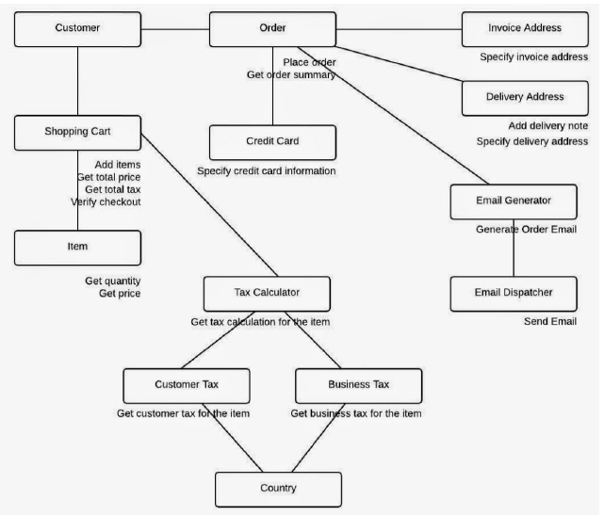

Slide 27
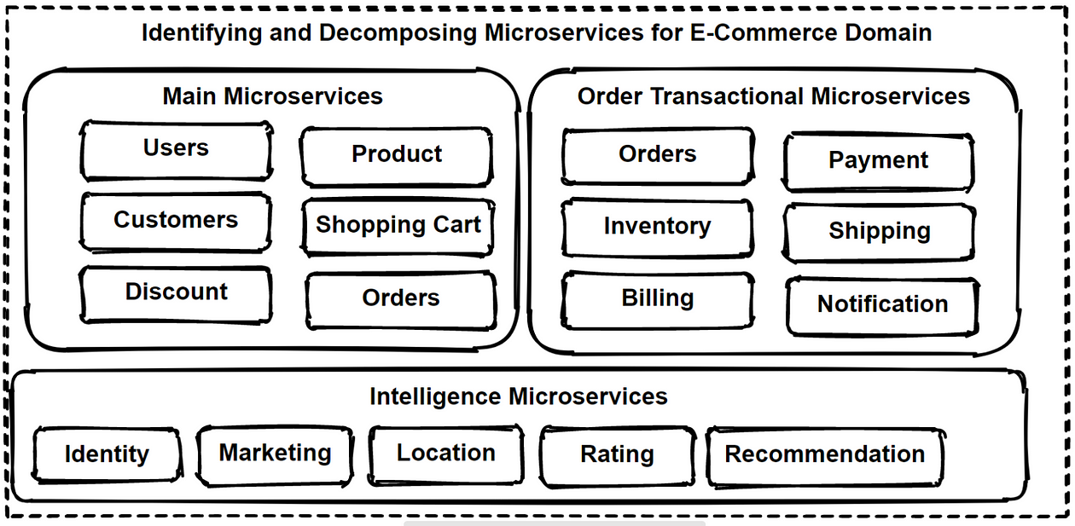

Slide 28
Refactoring
Notes:
https://aws.amazon.com/blogs/compute/deploying-java-microservices-on-amazon-ec2-container-service/
https://github.com/aws-samples/amazon-ecs-java-microservices
https://docs.aws.amazon.com/prescriptive-guidance/latest/patterns/deploy-java-microservices-on-amazon-ecs-using-amazon-ecr-and-load-balancing.html

Slide 29
Strangler Pattern
Allows software teams to retire legacy systems incrementally and avoid the pitfalls of major rewrites.
Rather than completely disassemble an application system and rewrite its code, this pattern offers development teams a way to incrementally update sections of code and functionality without the need to completely shut the system down.
Eventually, all the services and components will be refactored to integrate with a new application system, and the legacy system can retire.
migration process can proceed as an iterative process rather than a complex rip-and-replace scramble.
One of the biggest components of the strangler pattern is the facade interface, which acts as the main point of interaction between the legacy system and the external apps and systems that call it
Notes:
https://www.techtarget.com/searchapparchitecture/tip/A-detailed-intro-to-the-strangler-pattern
What is the strangler pattern?
Picture a motorcycle that works, but could stand to undergo extensive overhauls that will make it run better. One option would be to completely take the motorcycle apart and spend months rebuilding until it works. However, how sure are you that it will run after you've finished replacing every part? And what if you want to use the motorcycle in the next few weeks, but can't while it's in the garage?
The solution there is to replace parts one at a time, ensure it works as expected, and move on to the next once it's done. This provides two major benefits. The first is that you can likely still run the motorcycle as parts are incrementally replaced, rather than having to wait for the rebuild. The second is that if a fix or replacement doesn't work, you'll have a much easier time identifying the problem since you do not have to examine everything at once. Eventually, you will end up with an updated motorcycle that never really stopped running.

Slide 30
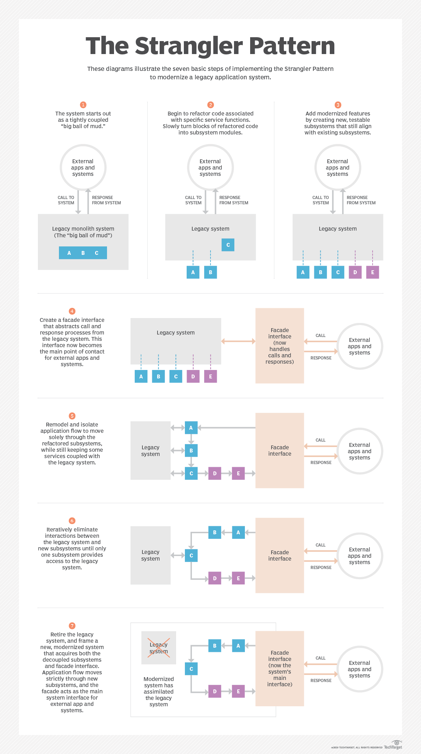
Implement Strangler Pattern
Notes:
https://samirbehara.com/2018/09/10/monolith-to-microservices-using-strangler-pattern/

Slide 31
Anti - Corruption Layer Pattern
Most systems rely on data or behaviours from another service or an external 3rd party. The problem is they often don’t share the same semantics or data structures. Left unchecked this leads to convoluting up your own boundary with concepts from another boundary.
ACL is a great way to isolate the logic of translation from external sources into the semantics defined within your own logical service boundary.
To interoperate with the legacy system, the new application may need to support outdated infrastructure, protocols, data models, APIs, or other features that you wouldn't otherwise put into a modern application.
The anti-corruption layer contains all of the logic necessary to translate between the two systems. The layer can be implemented as a component within the application or as an independent service.
Notes:
It’s all about translation and keeping external concepts out and not leaking in and pushing this translation to the outer edge.
For example, when a legacy application is migrated to a modern system, it may still need existing legacy resources. New features must be able to call the legacy system. This is especially true of gradual migrations, where different features of a larger application are moved to a modern system over time.

Slide 32
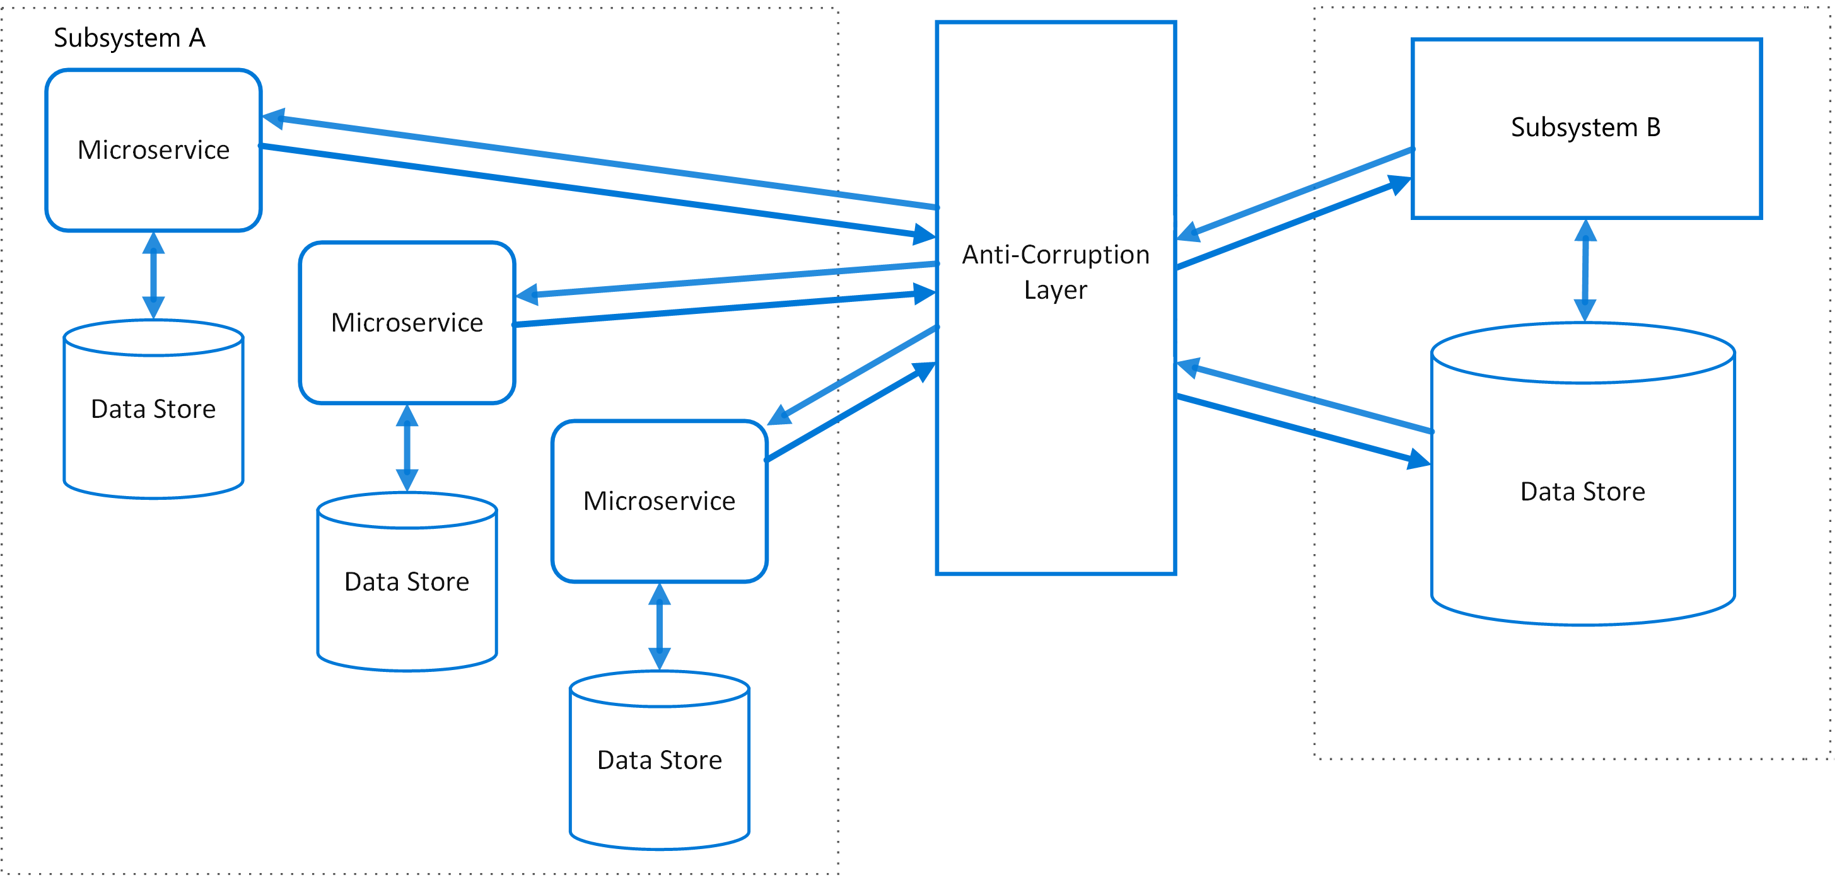
Anti - Corruption Layer Pattern
Notes:
It’s all about translation and keeping external concepts out and not leaking in and pushing this translation to the outer edge.
For example, when a legacy application is migrated to a modern system, it may still need existing legacy resources. New features must be able to call the legacy system. This is especially true of gradual migrations, where different features of a larger application are moved to a modern system over time.

Slide 33
Issues and considerations
Adds latency
Adds an additional service that must be managed and maintained.
Consider to scale.
Consider whether you need more than one anti-corruption layer.
Consider how the anti-corruption layer will be managed in relation with your other applications or services?
Make sure transaction and data consistency are maintained and can be monitored.
Consider if to handle all communication between different subsystems, or just a subset of features.
If the anti-corruption layer is part of an application migration strategy, consider whether it will be permanent, or will be retired after all legacy functionality has been migrated.
Use this pattern when:
A migration is planned to happen over multiple stages, but integration between new and legacy systems needs to be maintained.
Two or more subsystems have different semantics
Notes:
to calls made between the two systems.
Consider whether you need more than one anti-corruption layer. You may want to decompose functionality into multiple services using different technologies or languages, or there may be other reasons to partition the anti-corruption layer.
How will it be integrated into your monitoring, release, and configuration processes

Slide 34
Important Spring Cloud Modules
Dynamic Scale Up and Down. Using a combination of
Naming Server (Eureka) - for registering all microservices.
Ribbon (Client Side Load Balancing)
Feign (Easier REST Clients)
Visibility and Monitoring with
Zipkin Distributed Tracing
Netflix API/ Spring-CLoud Gateway
Configuration Management with
Spring Cloud Config Server
Fault Tolerance with
Hystrix/ Resilience
Notes:
https://www.journaldev.com/8195/spring-boot-cli-setup-and-helloworld-example

Slide 35
Naming Server
How does the Producer know how many instances of Consumer are active?
How does the Consumer distribute the load between the active instances.
Because we want this to be dynamic, we cannot hardcode the urls of Producer in Consumer. Thats why we bring in a Naming Server.
Notes:
Add the mysql specific information in application.properties as specified in previous slide

Slide 36
RestTemplate
Spring RestTemplate provides a convenient way to test RESTful web services.
RestTemplate class provides overloaded methods for different HTTP methods, such as GET, POST, PUT, DELETE etc.
Notes:
https://howtodoinjava.com/spring-restful/spring-restful-client-resttemplate-example/
https://docs.spring.io/spring/docs/current/javadoc-api/org/springframework/web/client/RestTemplate.html

Slide 37
Issues
Hard Coded URL’s
Code change requires for updates
Dynamic urls in cloud
Load Balancing : Multiple instances of same serice
Multiple Environments
Lets understand why hardcoded url wont work in cloud environment
Notes:
https://www.journaldev.com/8195/spring-boot-cli-setup-and-helloworld-example

Slide 38
1. Increased Services
Microservice architecture is all about breaking down monoliths into fine grained services.
This results in an increased number of services that forms a complex communication mesh.
Therefore, it is difficult for one service to maintain the network locations of all the other services, that it has to communicate with, in a property file
Notes:
https://www.journaldev.com/8195/spring-boot-cli-setup-and-helloworld-example

Slide 39
2. Dynamically assigned network locations:
Microservices are generally deployed in the cloud. Server instances in cloud have dynamically assigned network locations.
In addition, due to its basic features such as auto scaling, servers just come and go in cloud. Each time a service is started in a new instance, its network location changes
These complications raised the need to have a more sophisticated mechanism for microservices to dynamically discover the network locations of other microservices for communication.
Notes:
https://www.journaldev.com/8195/spring-boot-cli-setup-and-helloworld-example

Slide 40
Service Discovery

Slide 41
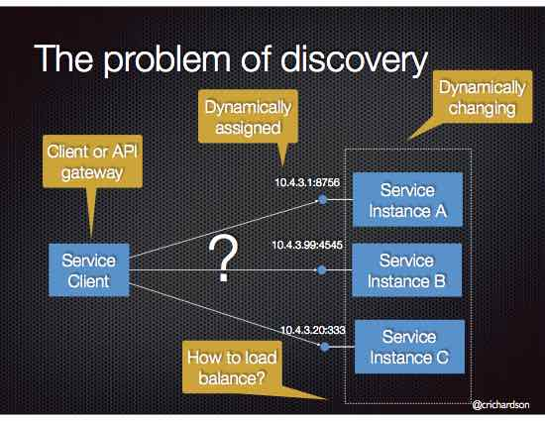
Problem
Implement a mechanism for that enables the clients of service to make requests to a dynamically changing set of ephemeral service instances.
Notes:
https://www.journaldev.com/8195/spring-boot-cli-setup-and-helloworld-example

Slide 42
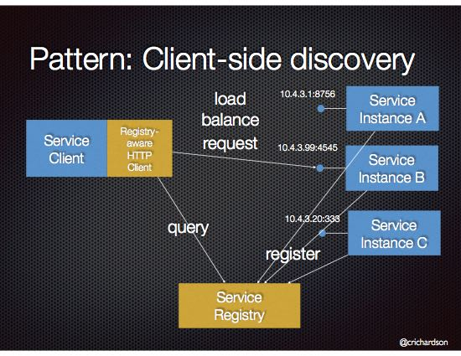
Client Side Discovery
When making a request to a service, the client obtains the location of a service instance by querying a Service Registry, which knows the locations of all service instances.
Notes:
The service discovery is implemented using Netflix OSS components. It provides Eureka, which is a Service Registry, and Ribbon, which is an HTTP client that queries Eureka in order to route HTTP requests to an available service instance.

Slide 43
Client Side Discovery
Client-side discovery has the following benefits:
Fewer moving parts and network hops compared to Server-side Discovery
Client-side discovery also has the following drawbacks:
This pattern couples the client to the Service Registry
You need to implement client-side service discovery logic for each programming language/framework used by your application, e.g Java/Scala, JavaScript/NodeJS. For example, Netflix Prana provides an HTTP proxy-based approach to service discovery for non-JVM clients.
Notes:
https://www.journaldev.com/8195/spring-boot-cli-setup-and-helloworld-example

Slide 44
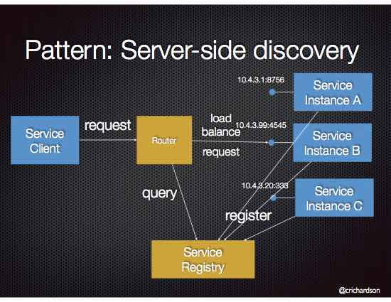
Server Side Discovery
When making a request to a service, the client makes a request via a router (a.k.a load balancer) that runs at a well known location. The router queries a service registry, which might be built into the router, and forwards the request to an available service instance
Notes:
https://www.journaldev.com/8195/spring-boot-cli-setup-and-helloworld-example

Slide 45
Server Side Discovery Example
An AWS Elastic Load Balancer (ELB) is an example of a server-side discovery router. An ELB also functions as a Service Registry
Some clustering solutions such as Kubernetes and Marathon run a proxy on each host that functions as a server-side discovery router. In order to access a service, a client connects to the local proxy using the port assigned to that service. The proxy then forwards the request to a service instance running somewhere in the cluster.
Notes:
A client makes HTTP(s) requests (or opens TCP connections) to the ELB, which load balances the traffic amongst a set of EC2 instances. An ELB can load balance either external traffic from the Internet or, when deployed in a VPC, load balance internal traffic.. EC2 instances are registered with the ELB either explicitly via an API call or automatically as part of an auto-scaling group

Slide 46
Server Side Discovery Pros and Cons
Server-side service discovery has a number of benefits:
Compared to client-side discovery, the client code is simpler since it does not have to deal with discovery. Instead, a client simply makes a request to the router
Some cloud environments provide this functionality, e.g. AWS Elastic Load Balancer
It also has the following drawbacks:
Unless it’s part of the cloud environment, the router must is another system component that must be installed and configured. It will also need to be replicated for availability and capacity.
The router must support the necessary communication protocols (e.g HTTP, gRPC, Thrift, etc) unless it is TCP-based router
More network hops are required than when using Client Side Discovery
Notes:
A client makes HTTP(s) requests (or opens TCP connections) to the ELB, which load balances the traffic amongst a set of EC2 instances. An ELB can load balance either external traffic from the Internet or, when deployed in a VPC, load balance internal traffic.. EC2 instances are registered with the ELB either explicitly via an API call or automatically as part of an auto-scaling group

Slide 47
Service Discovery
Service discovery mechanism uses a central registry to maintain the network locations of all the microservices. If for some reason the IP address and the port number of a particular microservice changes, new values will be immediately re-registered in the registry.
To maintain and discover a service with dynamic addresses, we need “Service Registration and Discovery”
One dedicated server is responsible to maintain all microservices deployed and registered
Acts like a phonebook of all microservices
Spring provides Eureka server to maintain the microservices and monitor the health if the microservice registered with Eureka
Spring cloud provides multiple solutions such as Eureka, Zookeeper, Cloud Foundry and Consul to facilitate the process of service discovery
There are 2 options for service instances to register with the service registry.
Self registration pattern - service instances register themselves.
3rd party registration pattern - a 3rd party registers the service instances with the service registry.
Notes:
For example, Netflix Eureka service instances are typically deployed using elastic IP addresses. The available pool of Elastic IP addresses is configured using either a properties file or via DNS. When a Eureka instance starts up it consults the configuration to determine which available Elastic IP address to use. A Eureka client is also configured with the pool of Elastic IP addresses.

Slide 48
Example - MS

Slide 49
Eureka Server
A REST based service which is primarily used for acquiring information about services that you would want to communicate with.
This REST service is also known as Eureka Server. The Services that register in Eureka Server to obtain information about each other are called Eureka Clients.
Notes:
https://www.journaldev.com/8195/spring-boot-cli-setup-and-helloworld-example

Slide 50
Feign Clients
Feign provide a better alternative to RestTemplate to call REST API.
Making the call using the proxy is very simple.
convenient way to test your application’s API, focused on creating tests to verify business logic instead of spending time on the technical implementation of web services clients.
You only need to describe how to reach the remote API service by providing details such as the URL, request and response body, accepted headers, etc. The Feign Client will take care of the implementation details.
Notes:
https://www.journaldev.com/8195/spring-boot-cli-setup-and-helloworld-example

Slide 51
Load balancers
load balancing improves the distribution of workloads across multiple computing resources, such as computers, a computer cluster, network links, central processing units, or disk drives.
Load balancing aims to optimize resource use, maximize throughput, minimize response time, and avoid overload of any single resource.
Using multiple components with load balancing instead of a single component may increase reliability and availability through redundancy.
Load balancing usually involves dedicated software or hardware, such as a multilayer switch or a Domain Name System server process.
Suppose other modules are also calling and consuming employee-producer module services. So the load at employee-producer is high. To deal with this we this we deploy multiple instances of employee-producer. Suppose two in this case. Now we will have to use a Load Balancer to route any incoming requests to either one of these two services.
Notes:
http://www.springboottutorial.com/microservices-with-spring-boot-part-5-eureka-naming-server

Slide 52
Serverless

Slide 53
Serverless Deployment
A deployment infrastructure that hides any concept of servers (i.e. reserved or preallocated resources)- physical or virtual hosts, or containers.
The infrastructure takes your service’s code and runs it. You are charged for each request based on the resources consumed.
Different serverless deployment environments:
AWS Lambda
Google Cloud Functions
Azure Functions
An AWS Lambda function is a stateless component that is invoked to handle events
The benefits of using serverless deployment include:
It eliminates the need to spend time on the undifferentiated heavy lifting of managing low-level infrastructure. Instead, you can focus on your code.
The serverless deployment infrastructure is extremely elastic. It automatically scales your services to handle the load.
You pay for each request rather than provisioning what might be under utilized virtual machines or containers.
Notes:
To deploy your service using this approach, you package the code (e.g. as a ZIP file), upload it to the deployment infrastructure and describe the desired performance characteristics.
The deployment infrastructure is a utility operated by a public cloud provider. It typically uses either containers or virtual machines to isolate the services. However, these details are hidden from you. Neither you nor anyone else in your organization is responsible for managing any low-level infrastructure such as operating systems, virtual machines, etc.

Slide 54
Serverless Deployment Drawback
Significant limitation and constraints – A serverless deployment environment typically has far more constraints that a VM-based or Container-based infrastructure.
Limited “input sources” – lambdas can only respond to requests from a limited set of input sources.
Applications must startup quickly – serverless deployment is not a good fit your service takes a long time to start
Risk of high latency – the time it takes for the infrastructure to provision an instance of your function and for the function to initialize might result in significant latency.
Notes:
https://intellipaat.com/blog/tutorial/amazon-web-services-aws-tutorial/aws-lambda-tutorial/
Significant limitation and constraints - A serverless deployment environment typically has far more constraints that a VM-based or Container-based infrastructure. For example, AWS Lambda only supports a few languages. It is only suitable for deploying stateless applications that run in response to a request. You cannot deploy a long running stateful application such as a database or message broker.
Limited “input sources” - lambdas can only respond to requests from a limited set of input sources. AWS Lambda is not intended to run services that, for example, subscribe to a message broker such as RabbitMQ.
Applications must startup quickly - serverless deployment is not a good fit your service takes a long time to start
Risk of high latency - the time it takes for the infrastructure to provision an instance of your function and for the function to initialize might result in significant latency. Moreover, a serverless deployment infrastructure can only react to increases in load. You cannot proactively pre-provision capacity. As a result, your application might initially exhibit high latency when there are sudden, massive spikes in load.
For example, a typical use case for serverless is to run an application service that resizes images uploaded by users. In this scenario, developers would set up triggers that execute the serverless function whenever a user uploads a new image to the application. The serverless function would then do its job and stop running as soon as it’s complete.

Slide 55
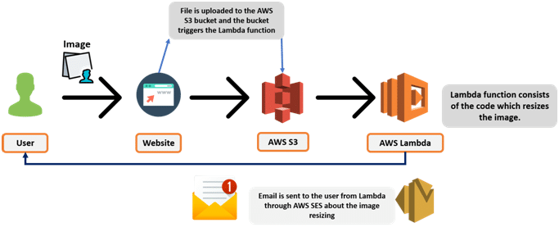
Serverless Deployment Example
https://docs.aws.amazon.com/lambda/latest/dg/with-s3-tutorial.html

Slide 56
Circuit Breaker

Slide 57
Why Circuit Breakers
A typical distributed system consists of many services collaborating together.
These services are prone to failure or delayed responses.
If a service fails it may impact on other services affecting performance and possibly making other parts of application inaccessible or in the worst case bring down the whole application.
A fallback is require for the service that fails.
Possible solutions:
Throw an error
Return fallback default response
Cache previous responses and use that as fallback response

Slide 58
Circuit breaker States and Settings
A CircuitBreaker can be in one of the three states:
CLOSED – everything is fine, no short-circuiting involved
OPEN – remote server is down, all requests to it are short-circuited
HALF_OPEN – a configured amount of time since entering OPEN state has elapsed and CircuitBreaker allows requests to check if the remote service is back online
We can configure the following settings:
the failure rate threshold above which the CircuitBreaker opens and starts short-circuiting calls
the wait duration which defines how long the CircuitBreaker should stay open before it switches to half open
the size of the ring buffer when the CircuitBreaker is half open or closed
a custom CircuitBreakerEventListener which handles CircuitBreaker events
a custom Predicate which evaluates if an exception should count as a failure and thus increase the failure rate

Slide 59
Hystrix
Uses Circuit-Breaker pattern
When to break circuit
What to do when circuit breaks
When to resume requests
When we apply a circuit breaker to a method, Hystrix watches for failing calls to that method, and if failures build up to a threshold, Hystrix opens the circuit so that subsequent calls automatically fail.
While the circuit is open, Hystrix redirects calls to the method, and they’re passed on to our specified fallback method.
Looks for any method annotated with the @HystrixCommand annotation, and wraps that method in a proxy connected to a circuit breaker so that Hystrix can monitor it
Notes:
https://www.cars24.com/blog/hystrix-how-to-handle-cascading-failures-in-microservices/

Slide 60
Cross cutting concerns

Slide 61
Cross Cutting Concerns
A significant amount of time is spend writing the build logic and putting in place the mechanisms to handle cross-cutting concerns.
Examples of cross-cutting concern include:
Security - for example, REST APIs must be secured by requiring an Access Token
Externalized configuration - includes credentials, and network locations of external services such as databases and message brokers
Logging - configuring of a logging framework such as log4j or logback
Health check - a url that a monitoring service can “ping” to determine the health of the application
Metrics - measurements that provide insight into what the application is doing and how it is performing
Distributed tracing - instrument services with code that assigns each external request an unique identifier that is passed between services.
In a microservice architecture there are additional cross-cutting concerns that you have to deal with including service registration and discovery, and circuit breakers for reliably handling partial failure.

Slide 62
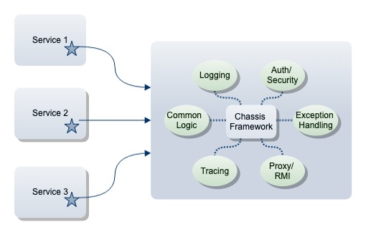
Microservice Chasis
It is designed to handle the unique types of cross-cutting concerns associated with distributed services.
The chassis implements
Reusable build logic that builds, and tests a service. This includes, for example, Gradle Plugins.
Mechanisms that handle cross-cutting concerns. The chassis typically assembles and configures a collection of frameworks and libraries that implement this functionality.
Notes:
As well as these generic cross-cutting concerns, there are also cross-cutting concerns that are specific to the technologies that an application uses. Applications that use infrastructure services such as databases or a message brokers require boilerplate configuration in order to do that. For example, applications that use a relational database must be configured with a connection pool. Web applications that process HTTP requests also need boilerplate configuration.
https://dev.to/lazypro/microservices-start-here-chassis-pattern-272j

Slide 63
Service Template
A source code template that a developer can copy in order to quickly start developing a new service.
A template is a simple runnable service that implements the required build logic and cross cutting concerns along with sample application logic.
This pattern has the following benefits:
a developer can quickly and easily start developing a new microservice.
it ensures that cross-cutting concerns are implemented in a standardized consistent way
it encourages developers to ‘do the right thing’
This pattern has the following drawbacks:
it’s a form of copy/paste programming.
This pattern has the following issues:
you need a service template for each programming language/framework that you want to use. This can be an obstacle to adopting a new programming language or framework.
Notes:
When you change the service template due to changing requirements, you must update existing services individually. Creating service repositories by forking the service template repository can minimize the work by leveraging Git. However, there’s a risk that services created at different points in time will diverge.

Slide 64
API Gateway

Slide 65
Without Gateway
Notes:
magine a scenario in which you have to implement a UI for a complex CRM (Customer Relationship Management) application. In order to populate different portions of this UI and perform different user operations, you may have to invoke dozens of microservices. Also, UI has to be aware of the network locations (host and port) of all these microservices. In addition, if the network location of a microservice changes (which tends to happen quite frequently in cloud), UI will also have to be updated. To state the obvious, it’s a very bad design.

Slide 66
With Gateway
Notes:
, a typical web application should have the support for monitoring, authentication, security, CORS and etc. If the UI is directly invoking the microservices, the aforementioned cross cutting concerns should be implemented in each and every microservice separately. A simple change in CORS policy or authentication mechanism would force changes in all the microservices, which is inefficient and error prone.
In order to have a more robust approach, we have to implement a single point of entry or a gateway for all the incoming traffic to microservices. UI will always send requests to the gateway and in turn the gateway will forward the requests to relevant microservices. Essentially, gateway acts as a middle-ware between the UI and the microservices. The following figure illustrates this concept.
The two prime advantages of this approach are as follows.
UI doesn’t need to be aware of the network locations of individual microservices. Instead, UI only needs to know the network location of the gateway. Gateway will route the incoming requests to relevant backend services.
Cross cutting concerns such as authentication, security, monitoring, CORS and etc will be handled by the gateway. Whenever a change is required in any of these aspects, that change can be made in a single place (gateway) to affect all the microservices.

Slide 67
API Gateway
Notes:
, a typical web application should have the support for monitoring, authentication, security, CORS and etc. If the UI is directly invoking the microservices, the aforementioned cross cutting concerns should be implemented in each and every microservice separately. A simple change in CORS policy or authentication mechanism would force changes in all the microservices, which is inefficient and error prone.
In order to have a more robust approach, we have to implement a single point of entry or a gateway for all the incoming traffic to microservices. UI will always send requests to the gateway and in turn the gateway will forward the requests to relevant microservices. Essentially, gateway acts as a middle-ware between the UI and the microservices. The following figure illustrates this concept.
The two prime advantages of this approach are as follows.
UI doesn’t need to be aware of the network locations of individual microservices. Instead, UI only needs to know the network location of the gateway. Gateway will route the incoming requests to relevant backend services.
Cross cutting concerns such as authentication, security, monitoring, CORS and etc will be handled by the gateway. Whenever a change is required in any of these aspects, that change can be made in a single place (gateway) to affect all the microservices.

Slide 68
Advantages of API Gateway
The advantages of this approach are as follows-
This improves the security of the microservices as we limit the access of external calls to all our services.
The cross cutting concerns like authentication, monitoring/metrics, and resiliency will be needed to be implemented only in the API Gateway as all our calls will be routed through it.
The client does not know about the internal architecture of our microservices system. Client will not be able to determine the location of the microservice instances.
Simplifies client interaction as he will need to access only a single service for all the requirements.

Slide 69
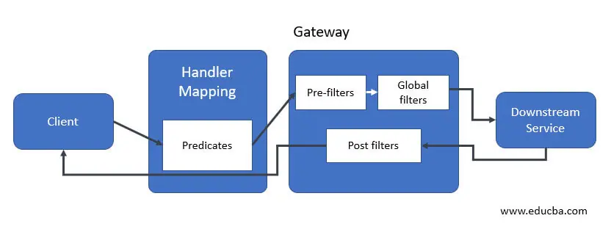
Spring Cloud Gateway
This architecture consists following components are as follows.
Client
Predicates
Mapping handler
Pre-filters
Global filters
Post filters
Downstream service
Notes:
https://exampledriven.wordpress.com/2016/07/06/spring-cloud-zuul-example/
https://www.mscharhag.com/spring/api-gateway-with-spring-cloud-zuul

Slide 70
Externalize Configuration

Slide 71
Why Externalize
An application typically uses one or more infrastructure and 3rd party services.
Examples of infrastructure services include: a Service registry, a message broker and a database server.
Examples of 3rd party services include: payment processing, email and messaging, etc.
A service must be provided with configuration data that tells it how to connect to the external/3rd party services.
A service must run in multiple environments
Different environments have different instances of the external/3rd party services
Externalize all application configuration including the database credentials and network location. On startup, a service reads the configuration from an external source, e.g. OS environment variables, etc.
Notes:
A service must be provided with configuration data that tells it how to connect to the external/3rd party services. For example, the database network location and credentials
A service must run in multiple environments - dev, test, qa, staging, production - without modification and/or recompilation
Different environments have different instances of the external/3rd party services, e.g. QA database vs. production database, test credit card processing account vs. production credit card processing account

Slide 72
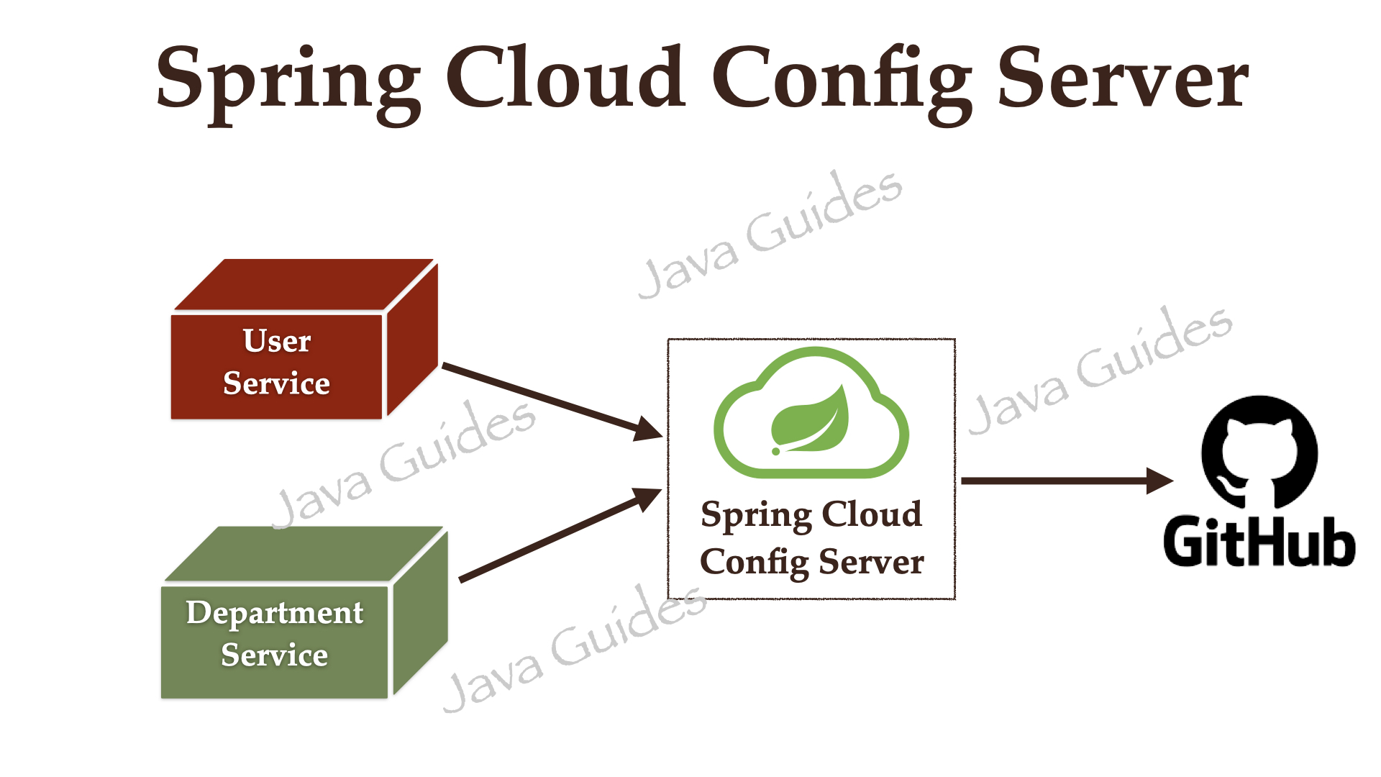
Spring Cloud Config
Create a Spring Cloud Config Server which provides the configuration values for all of our microservices.
We can use git, svn, database, or Consul as a backend to store the configuration parameters.
Configure the location of the Spring Cloud Config server in our microservice so that it will load all the properties when we start the application.
In addition to that, whenever we update the properties we can invoke the actuator/refresh the REST endpoint in our microservice so that it will reload the configuration changes without requiring us to restart the application.
Notes:
https://reflectoring.io/spring-boot-s3/

Slide 73
ThankYou
shalini06mittal@gmail.com
7738460004

